Slide 1
Methods of Computational Chemistry
Prepared By-
Faisal Imran
Assistant Professor
CSE, DIU

Slide 2
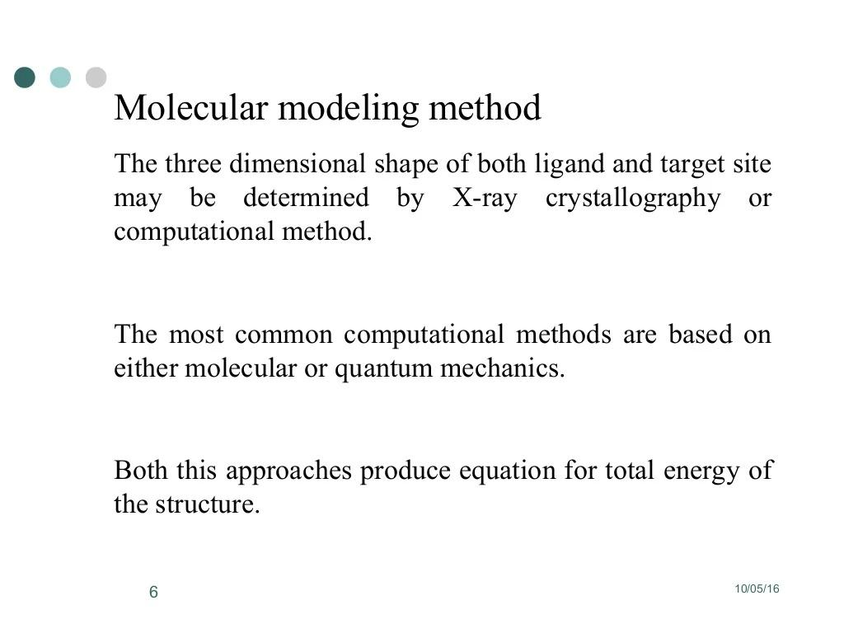

Slide 3
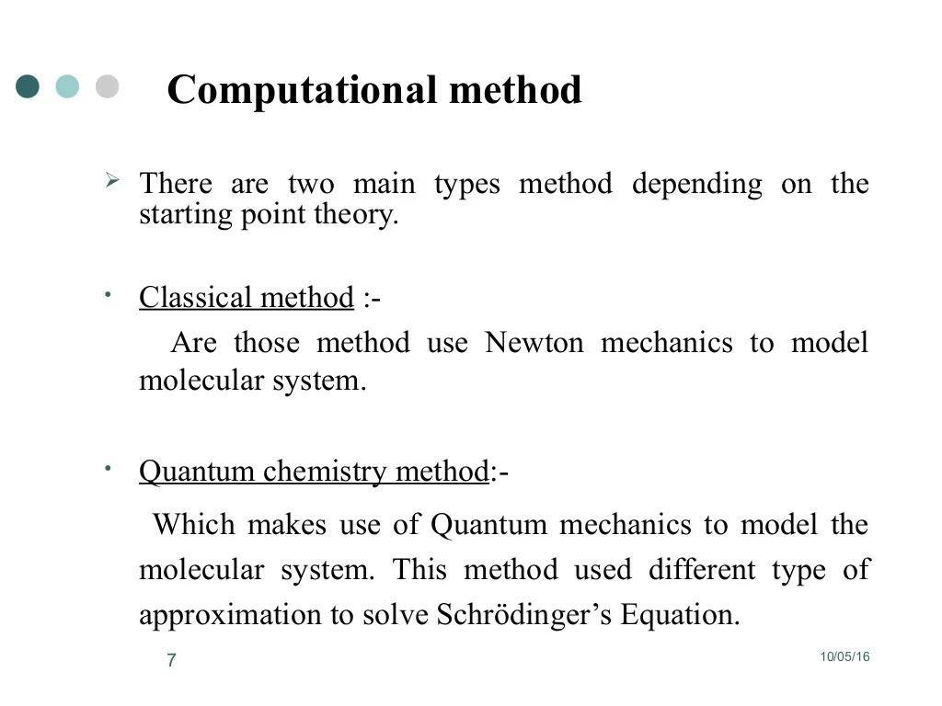

Slide 4
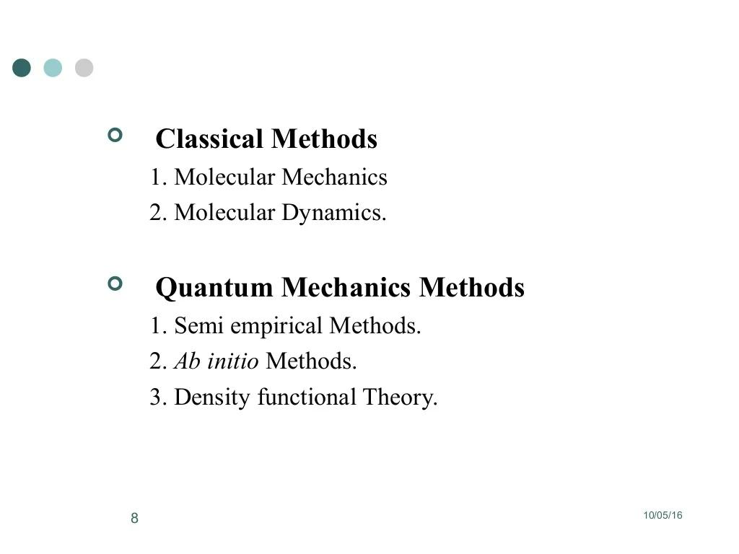

Slide 5
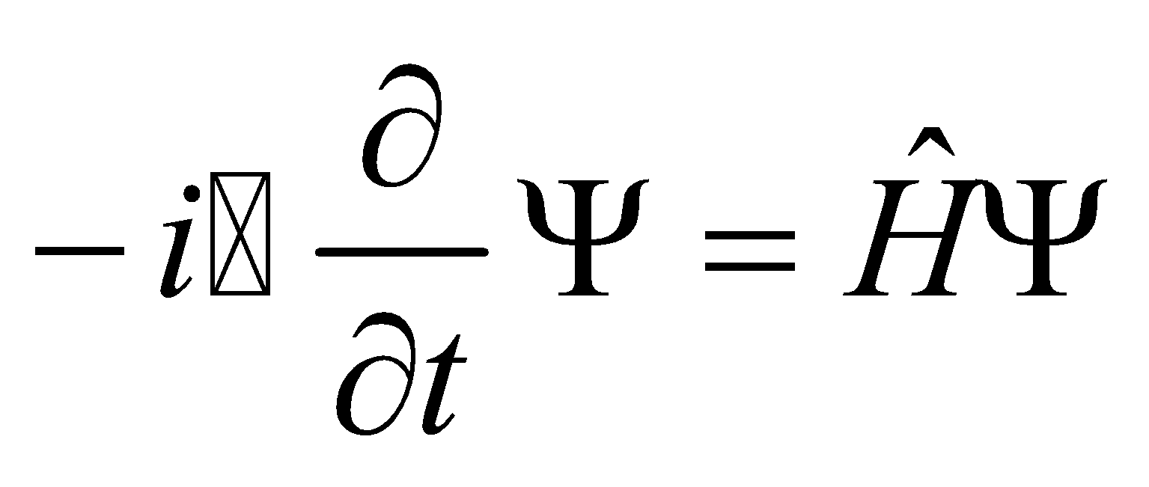
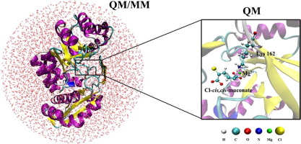
What is Computational Chemistry?
Application of computational methods and algorithms in chemistry
Quantum Mechanical
i.e., via Schrödinger Equation
also called Quantum Chemistry
Molecular Mechanical
i.e., via Newton’s law F=ma
also Molecular Dynamics
Empirical/Statistical
e.g., QSAR, etc., widely used in clinical and medicinal chemistry
Focus Today

Slide 6
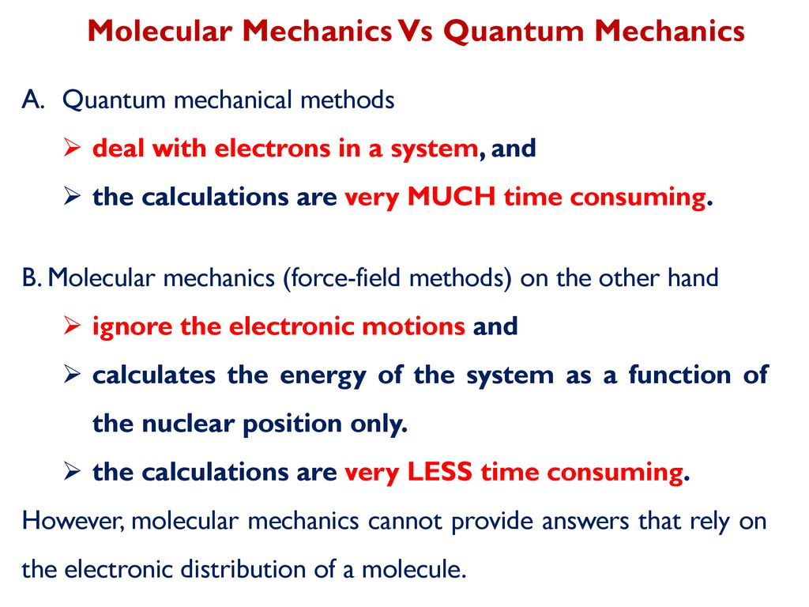
Differences Between Molecular Mechanics & Quantum Mechanics

Slide 7
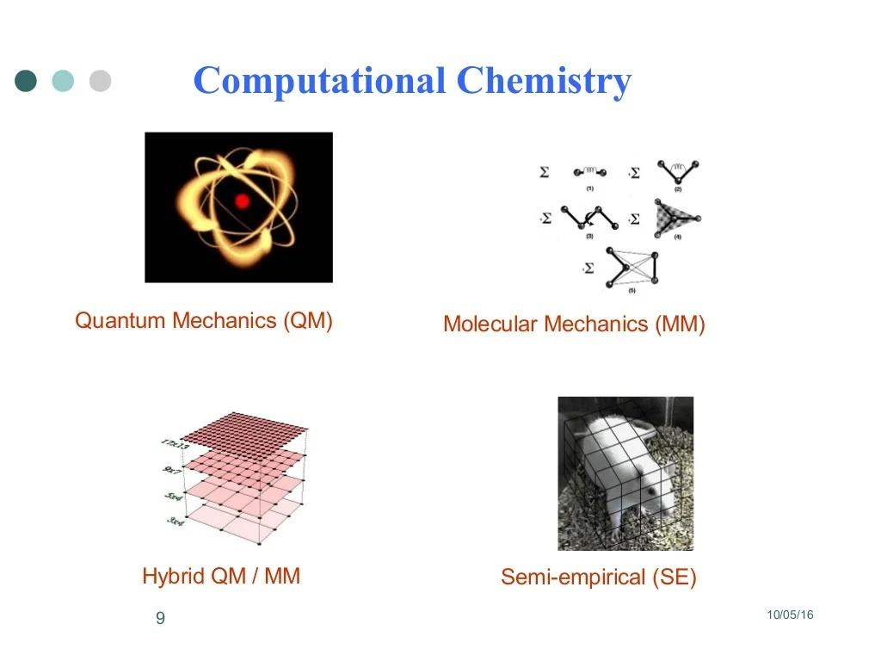

Slide 8
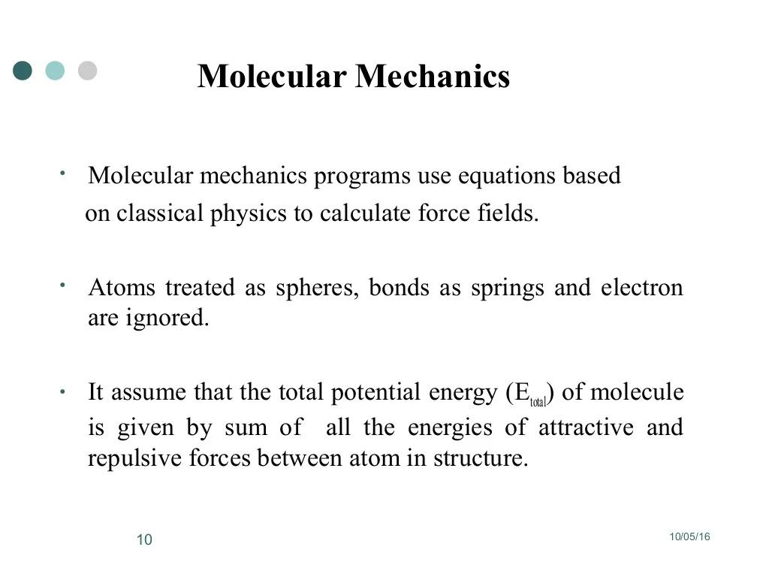

Slide 9
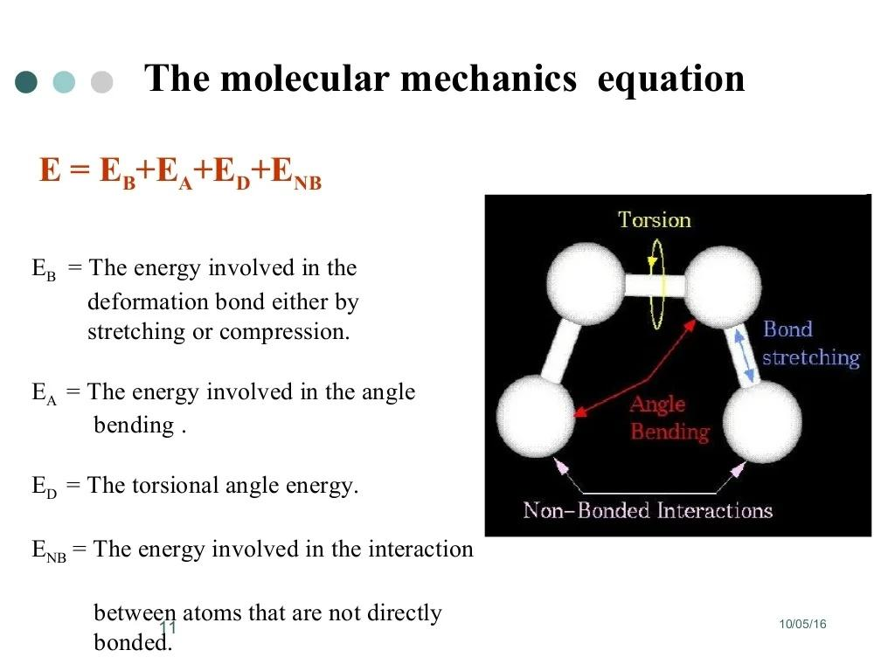

Slide 10
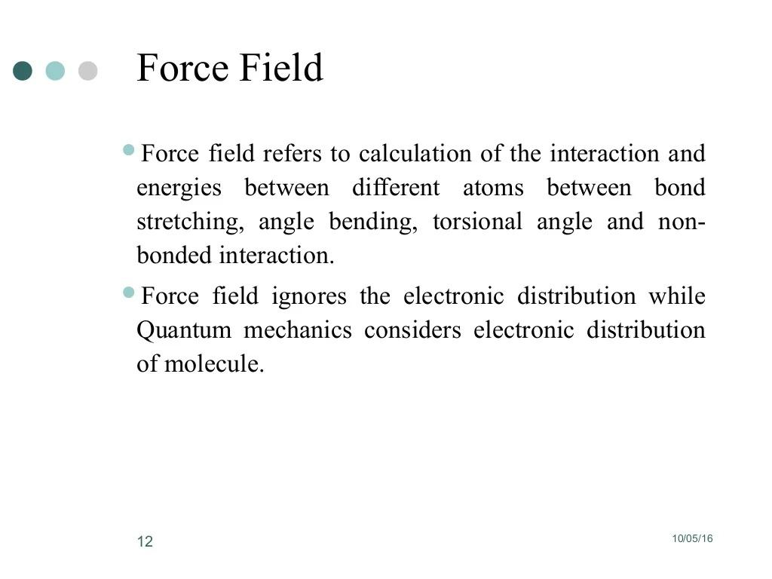

Slide 11
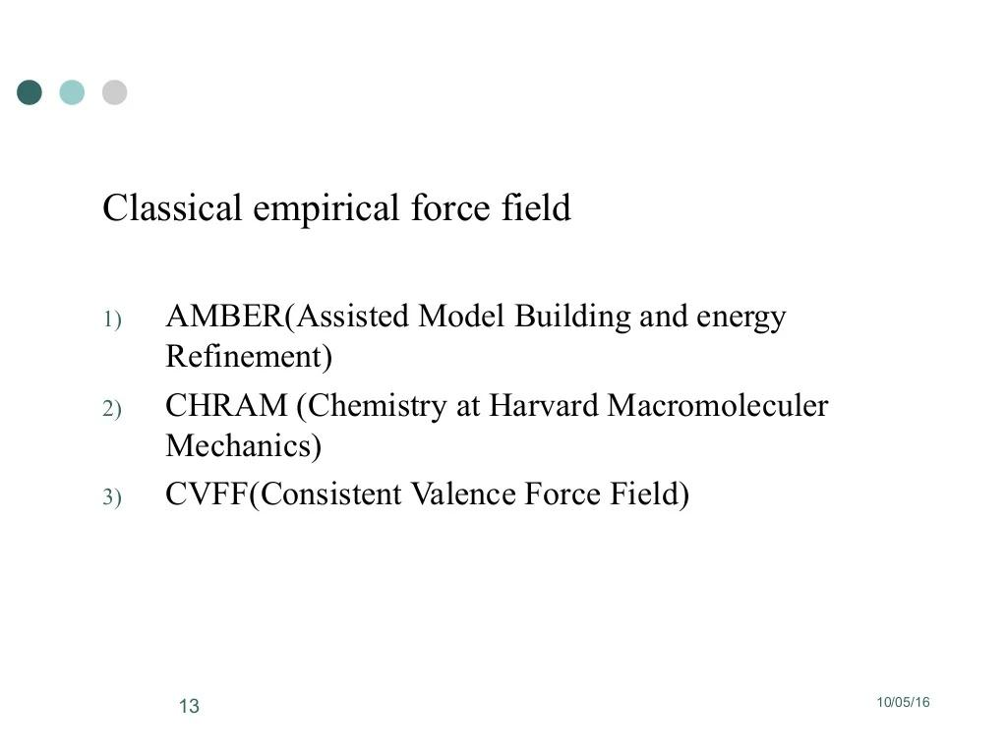

Slide 12
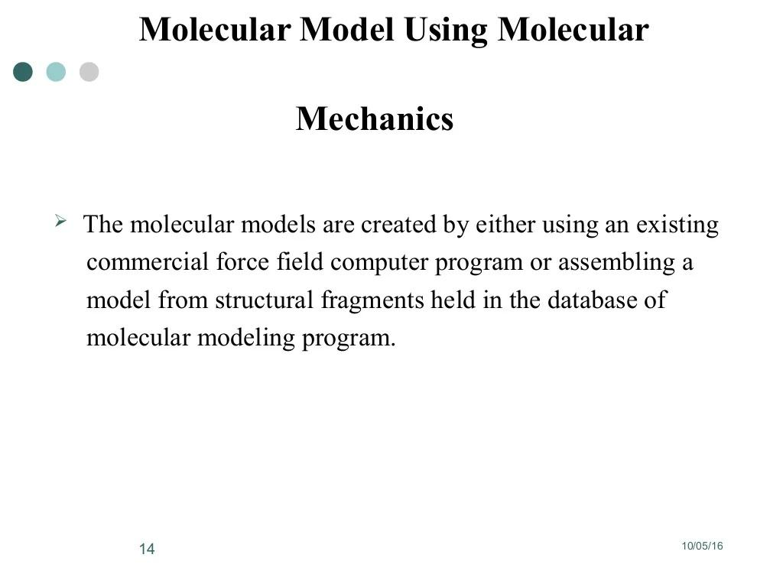

Slide 13
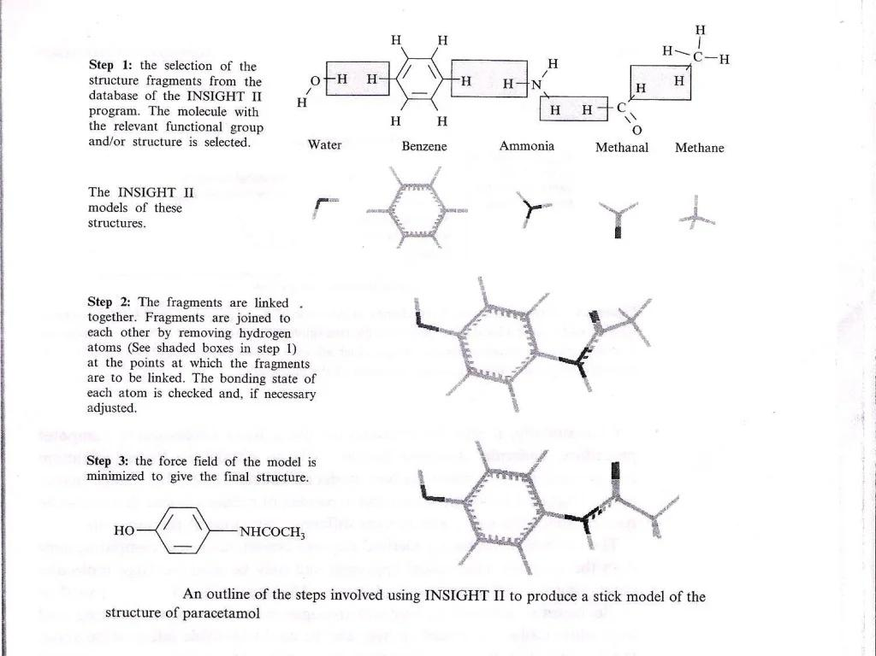

Slide 14
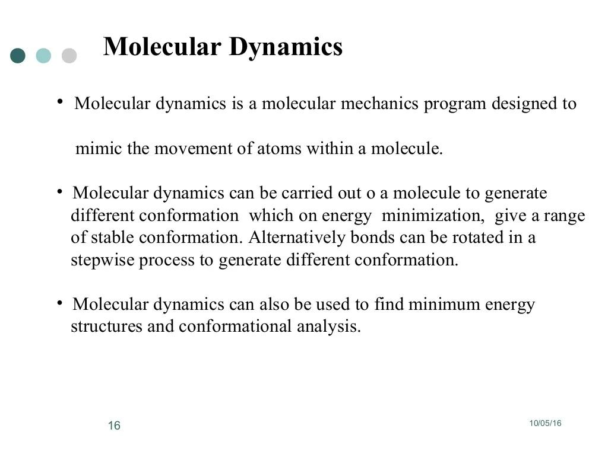

Slide 15
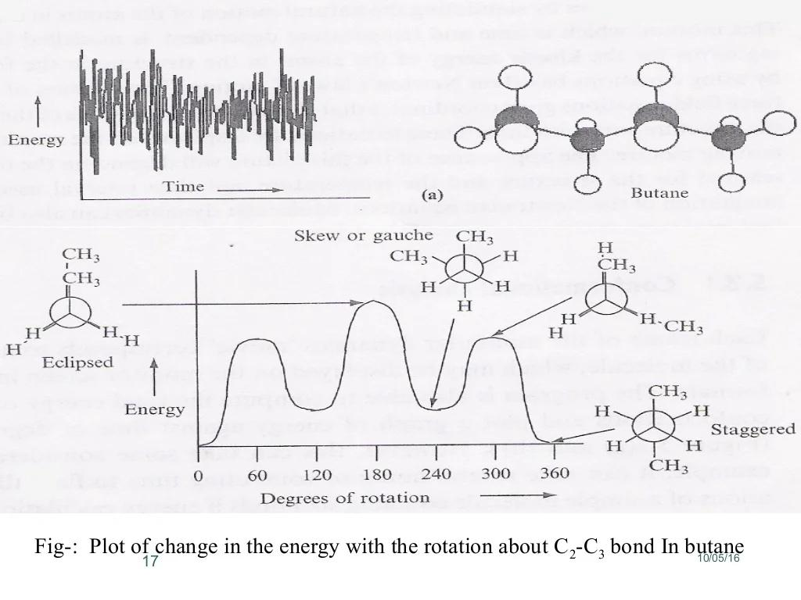

Slide 16
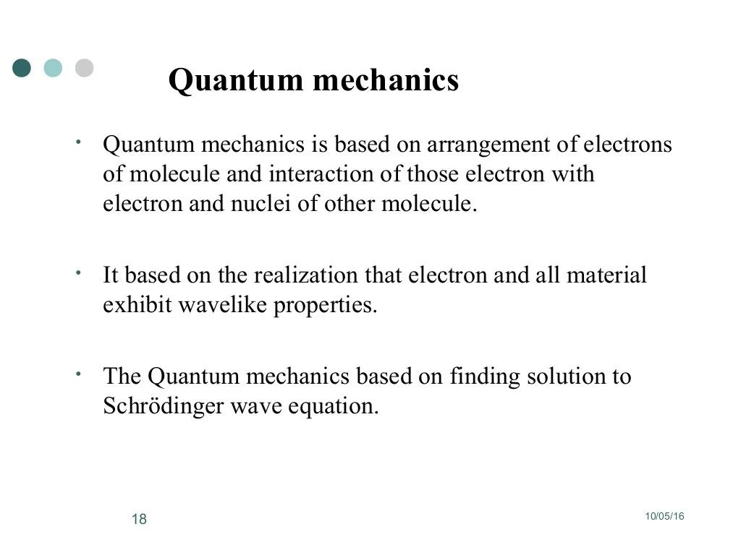

Slide 17
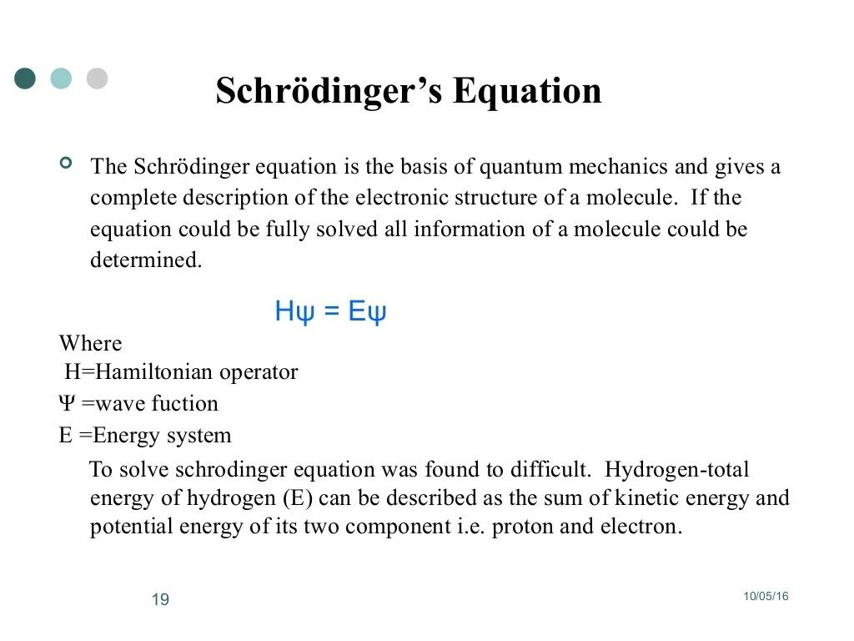

Slide 18
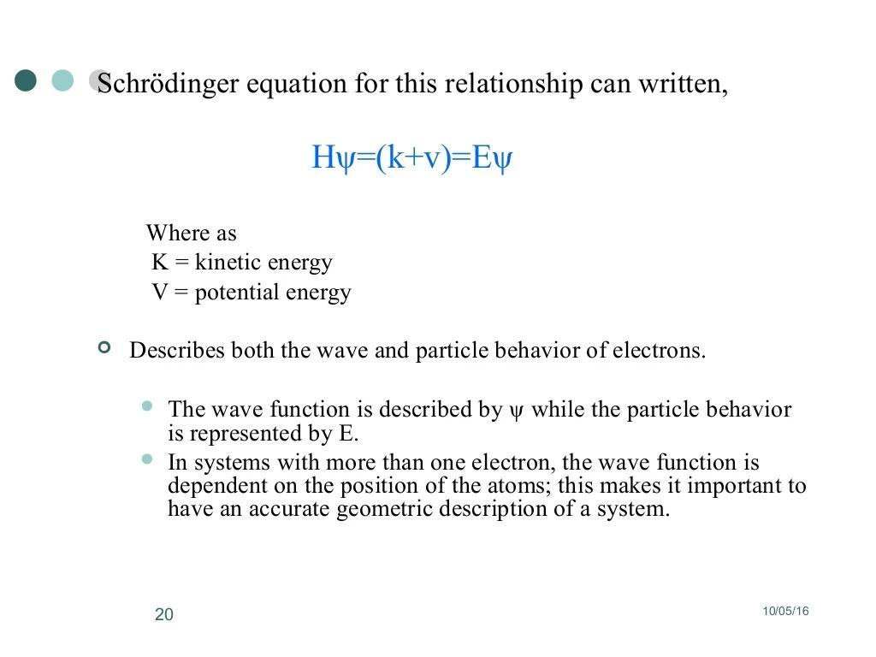

Slide 19
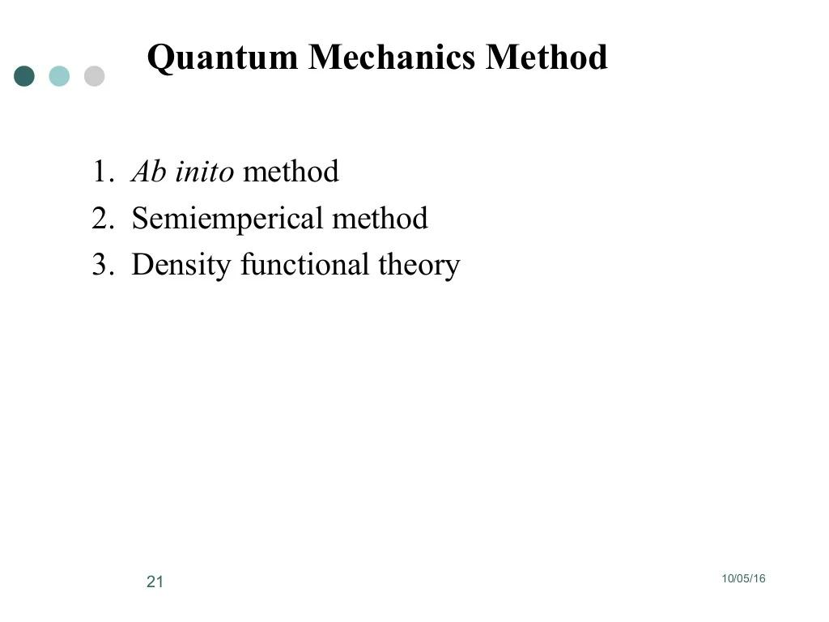

Slide 20
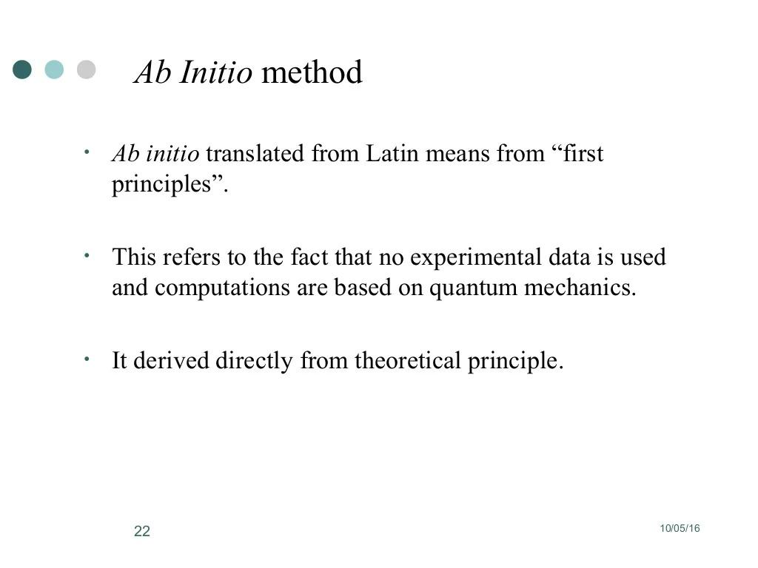

Slide 21
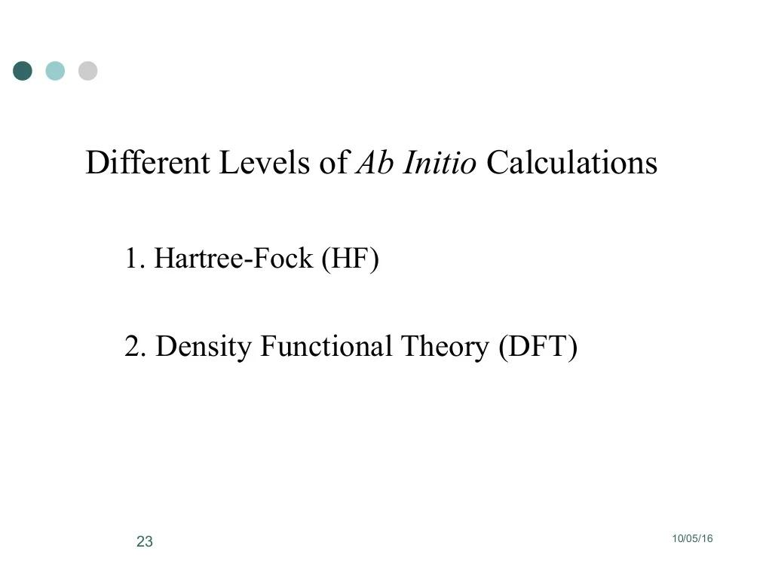

Slide 22
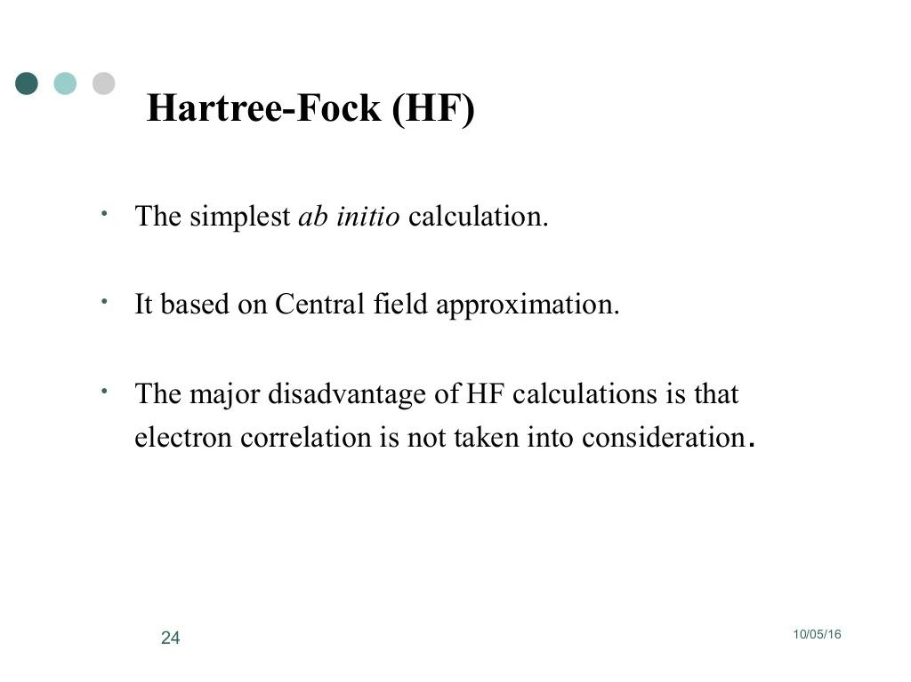

Slide 23
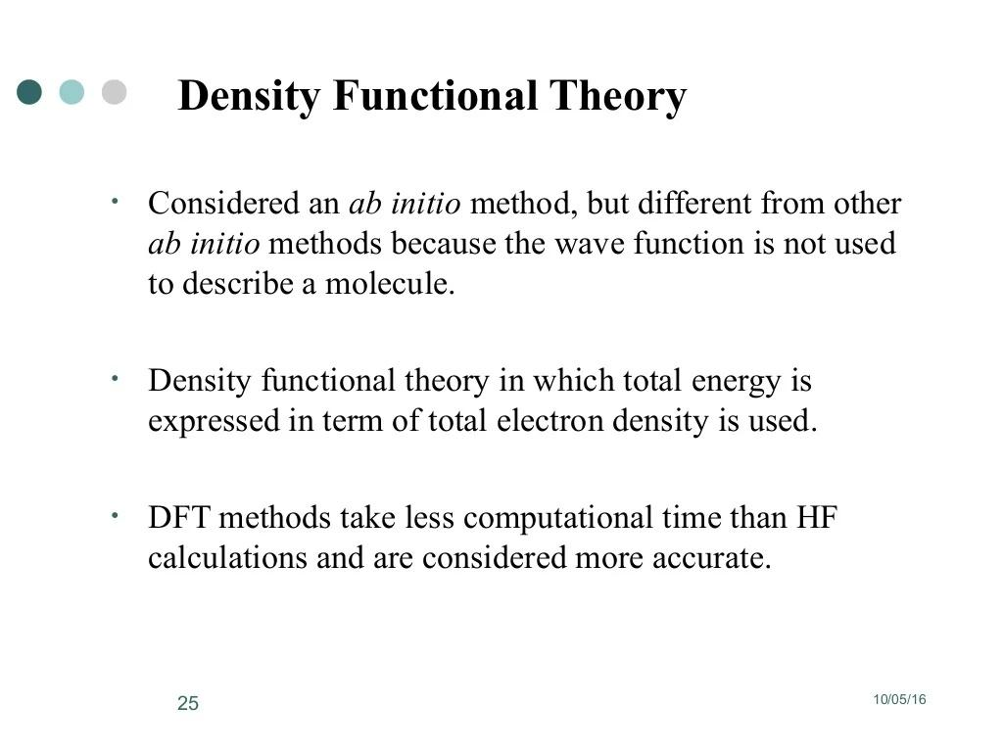

Slide 24
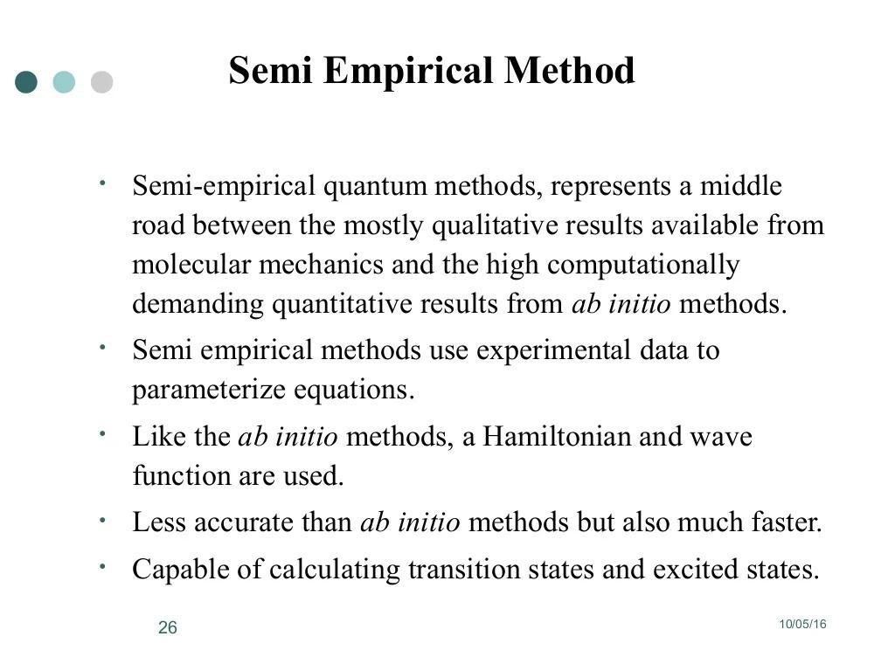

Slide 25
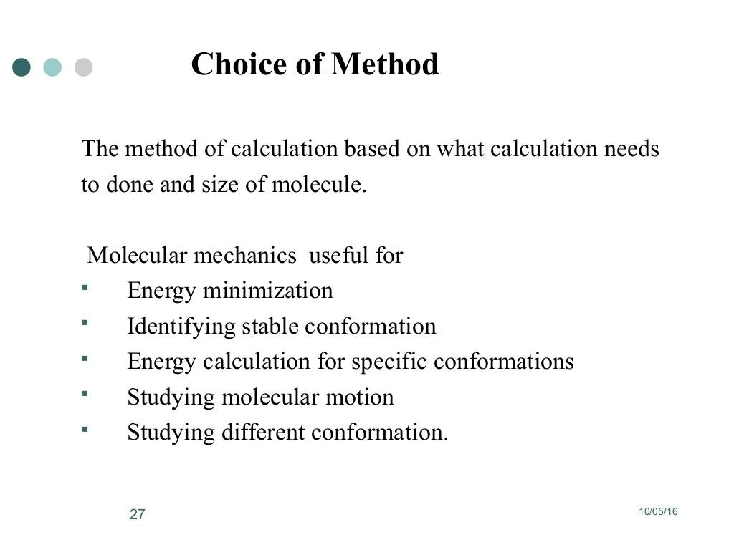

Slide 26
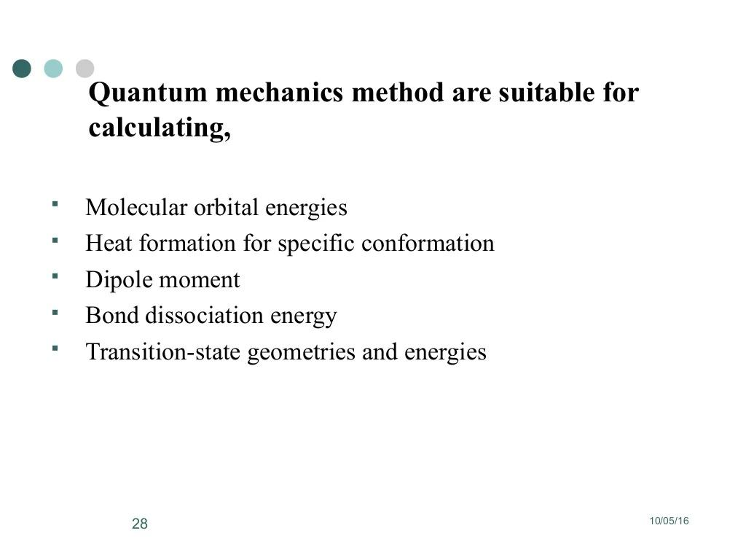

Slide 27
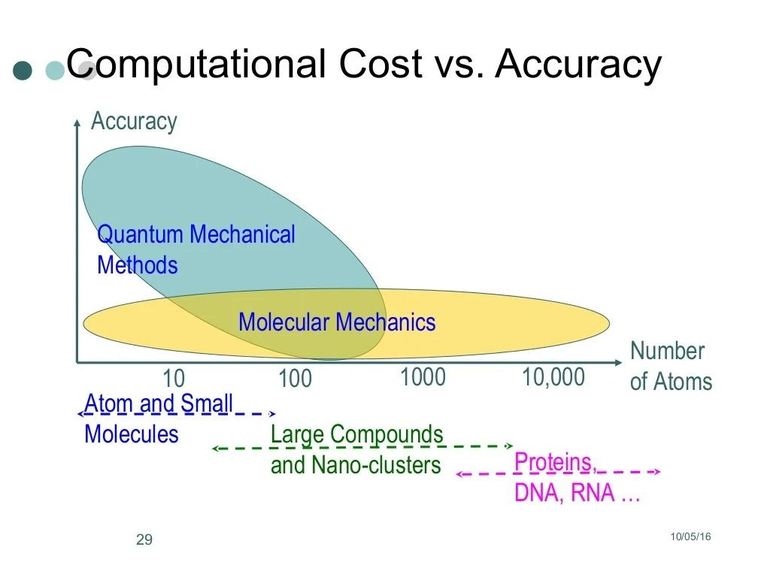

Slide 28
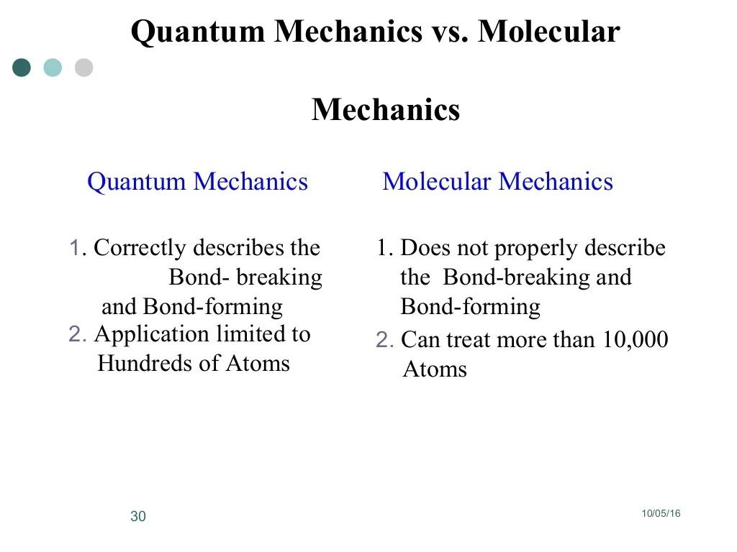

Slide 29
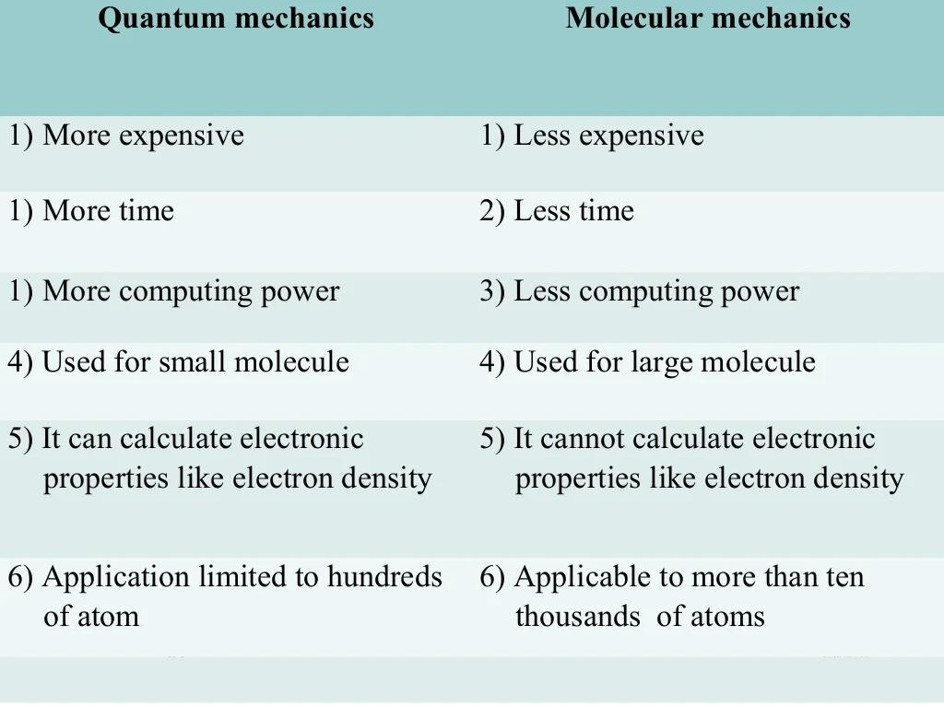

Slide 30
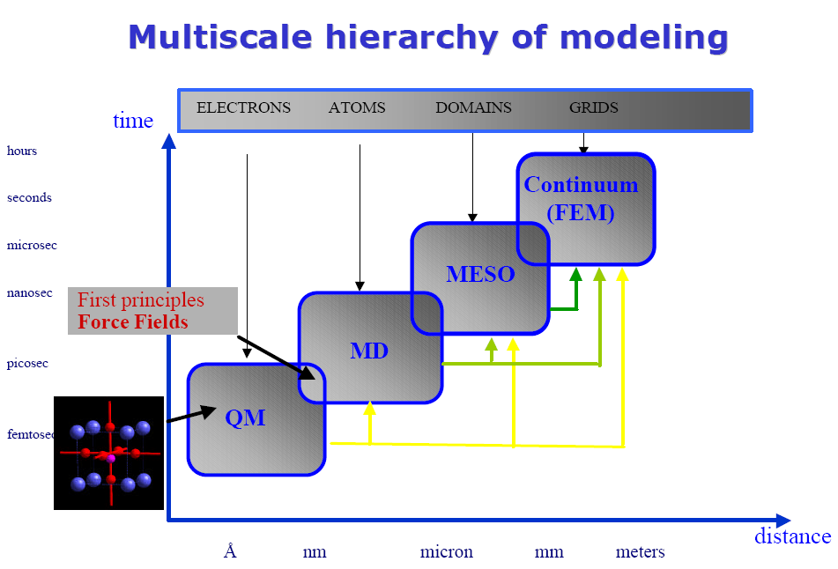
Multiscale Hierarchy of Modeling

Slide 31
How Big Systems Can We Deal with?
Assuming typical computing setup (number of CPUs, memory, disk space, etc.)
Ab initio method: ~100 atoms
DFT method: ~1000 atoms
Semi-empirical method: ~10,000 atoms
MM/MD: ~100,000 atoms

Slide 32
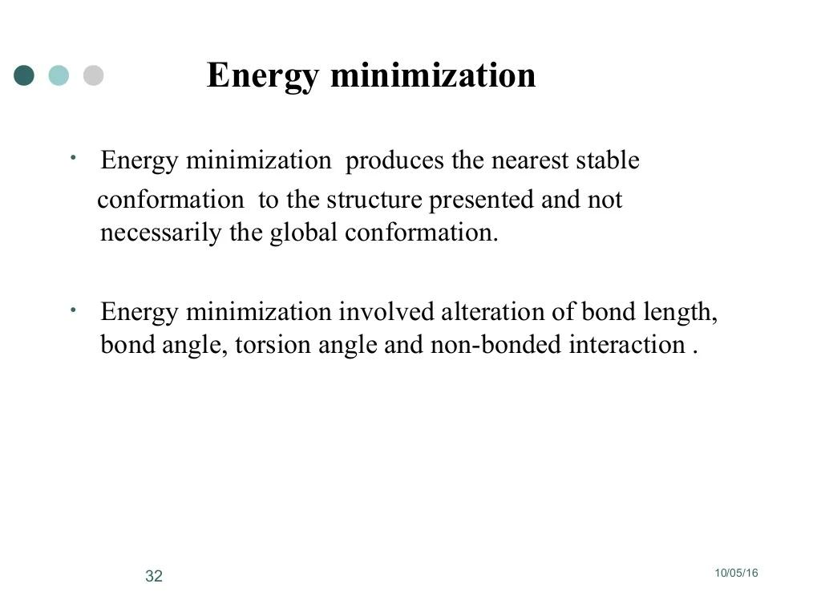

Slide 33
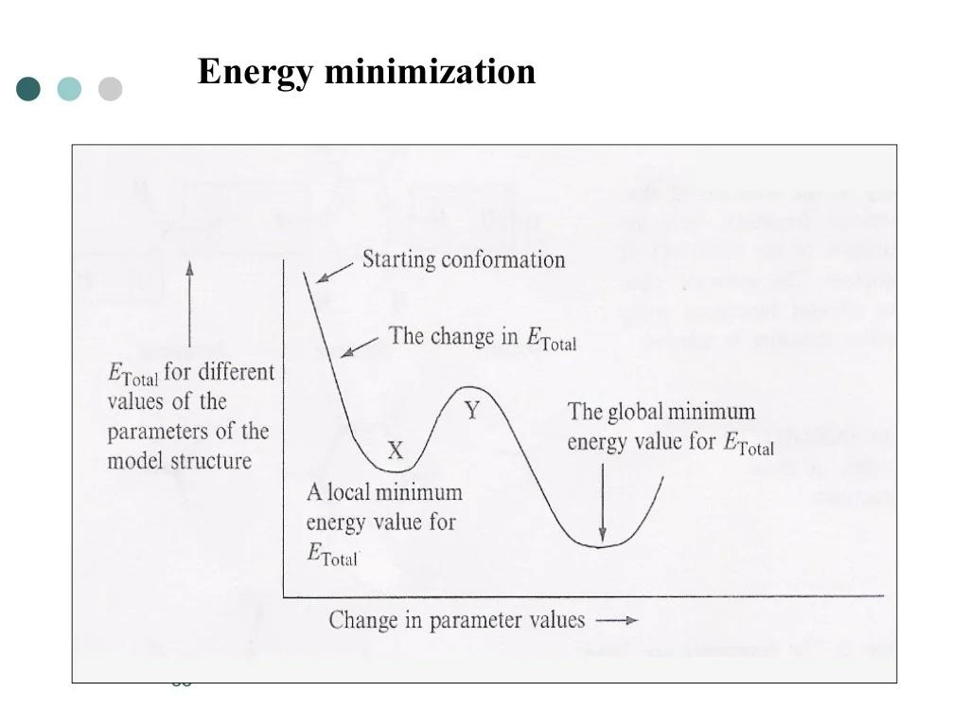

Slide 34
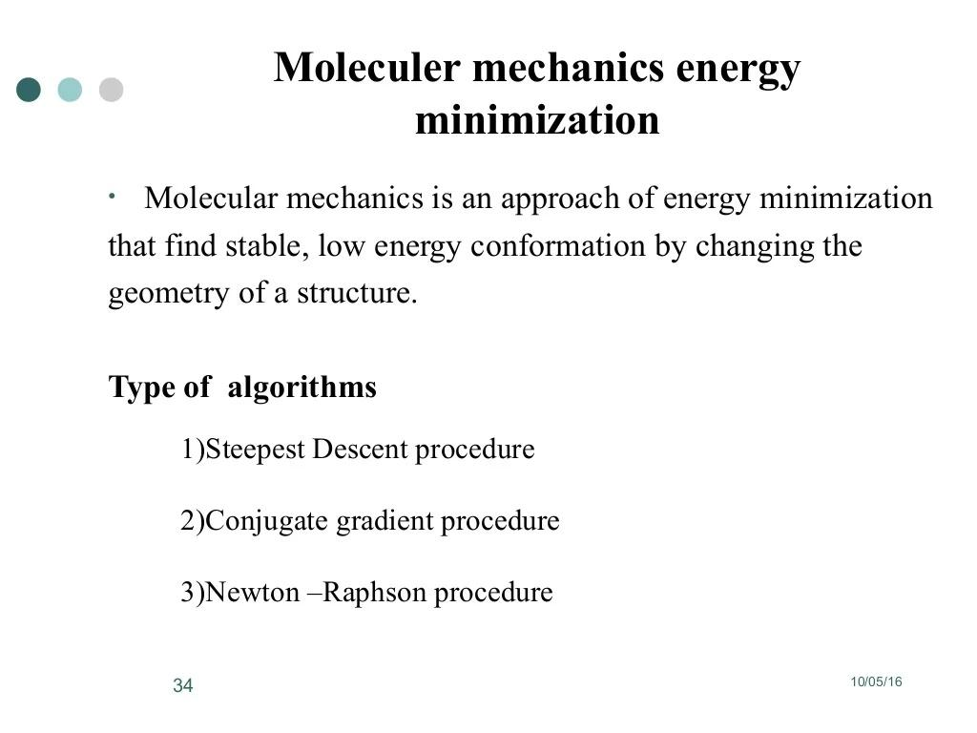

Slide 35
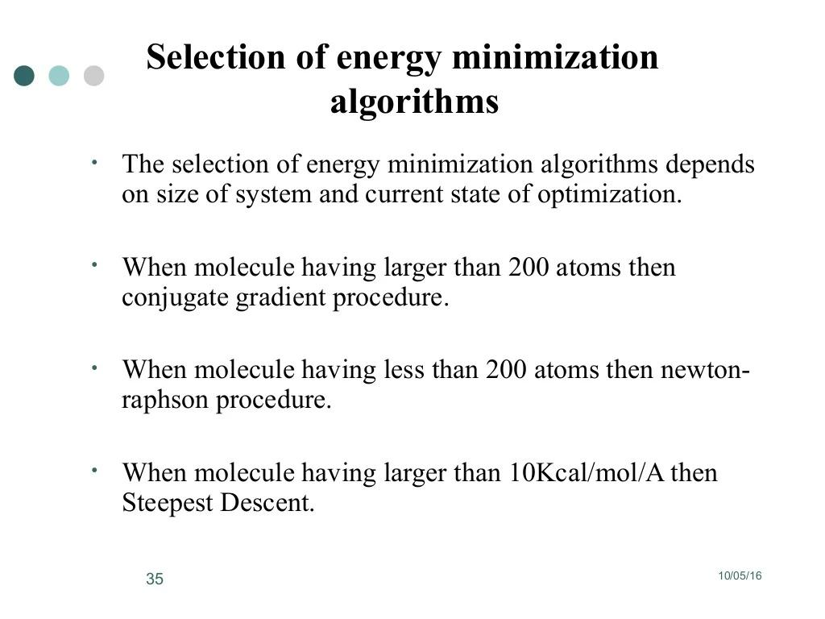

Slide 36
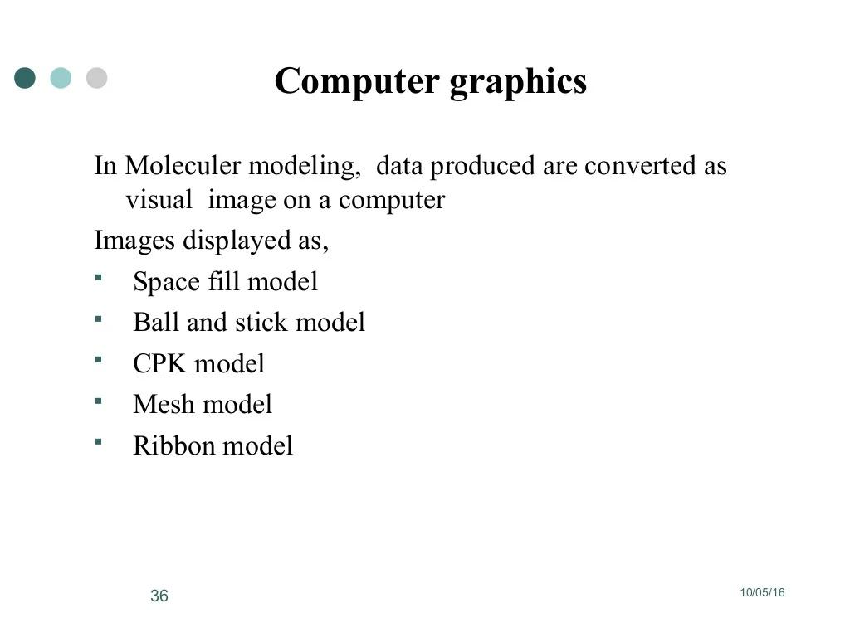

Slide 37
